Slide 1

Problem formulation
Recommender Systems
Machine Learning

Slide 2





Example: Predicting movie ratings
User rates movies using one to five stars
Movie | Alice (1) | Bob (2) | Carol (3) | Dave (4)
Love at last
Romance forever
Cute puppies of love
Nonstop car chases
Swords vs. karate
= no. users
= no. movies
= 1 if user has rated movie
= rating given by user to movie (defined only if
)

Slide 3
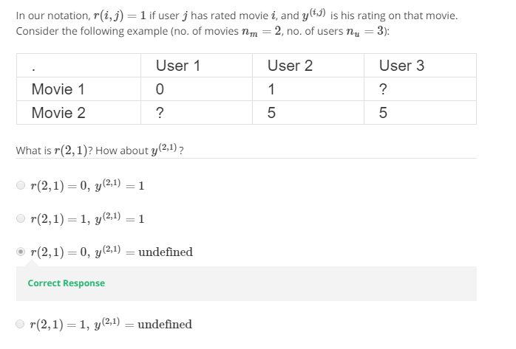

Slide 4
Content-based recommendations
Recommender Systems
Machine Learning

Slide 5






Content-based recommender systems
Movie | Alice (1) | Bob (2) | Carol (3) | Dave (4) | (romance) | (action)
Love at last | 5 | 5 | 0 | 0 | 0.9 | 0
Romance forever | 5 | ? | ? | 0 | 1.0 | 0.01
Cute puppies of love | ? | 4 | 0 | ? | 0.99 | 0
Nonstop car chases | 0 | 0 | 5 | 4 | 0.1 | 1.0
Swords vs. karate | 0 | 0 | 5 | ? | 0 | 0.9
For each user , learn a parameter . Predict user as rating movie with stars.
Notes:
Add dots

Slide 6






Problem formulation
if user has rated movie (0 otherwise)
rating by user on movie (if defined)
= parameter vector for user
= feature vector for movie
For user , movie , predicted rating:
= no. of movies rated by user
To learn :

Slide 7
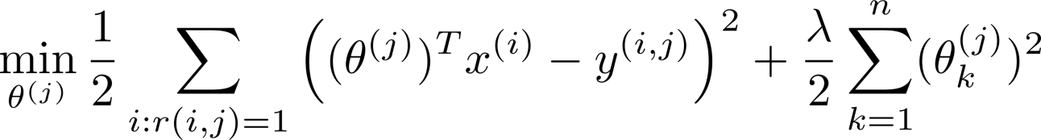
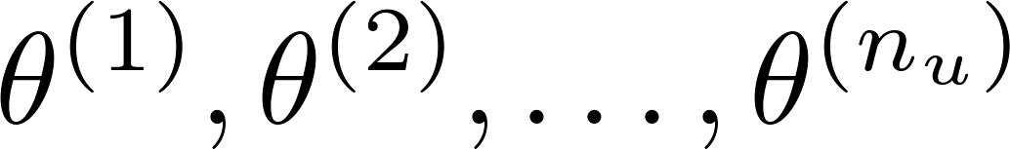
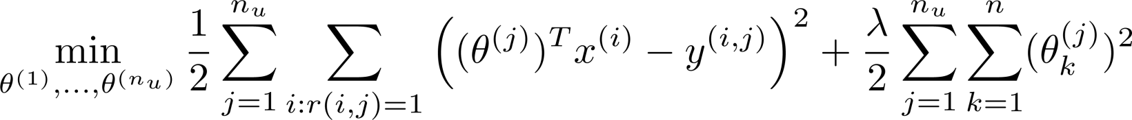
Optimization objective:
To learn (parameter for user ):
To learn :

Slide 8
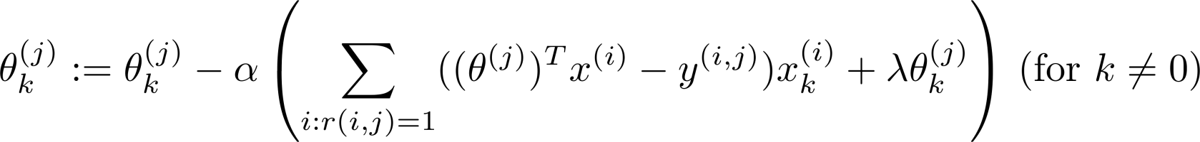
Optimization algorithm:
Gradient descent update:

Slide 9
Recommender Systems
Collaborative filtering
Machine Learning

Slide 10
Problem motivation
Movie | Alice (1) | Bob (2) | Carol (3) | Dave (4) | (romance) | (action)
Love at last | 5 | 5 | 0 | 0 | 0.9 | 0
Romance forever | 5 | ? | ? | 0 | 1.0 | 0.01
Cute puppies of love | ? | 4 | 0 | ? | 0.99 | 0
Nonstop car chases | 0 | 0 | 5 | 4 | 0.1 | 1.0
Swords vs. karate | 0 | 0 | 5 | ? | 0 | 0.9
Notes:
Change numbers to LATEX as well

Slide 11
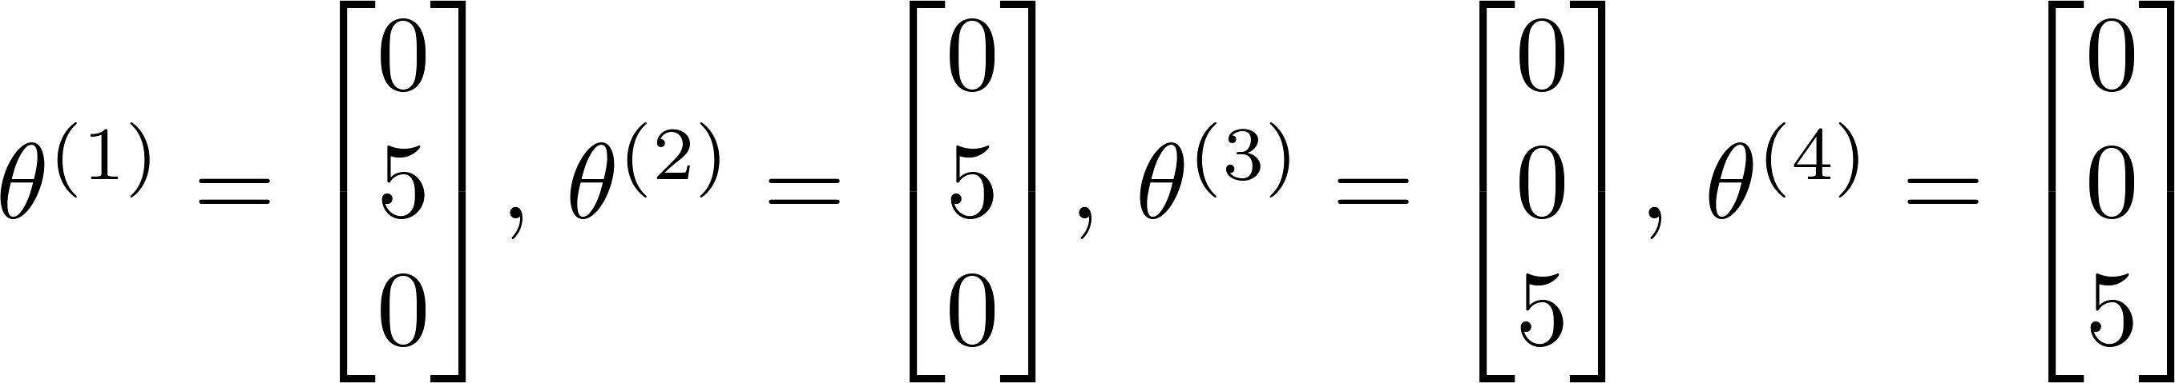
Problem motivation
Movie | Alice (1) | Bob (2) | Carol (3) | Dave (4) | (romance) | (action)
Love at last | 5 | 5 | 0 | 0 | ? | ?
Romance forever | 5 | ? | ? | 0 | ? | ?
Cute puppies of love | ? | 4 | 0 | ? | ? | ?
Nonstop car chases | 0 | 0 | 5 | 4 | ? | ?
Swords vs. karate | 0 | 0 | 5 | ? | ? | ?
Notes:
Change numbers to LATEX as well

Slide 12
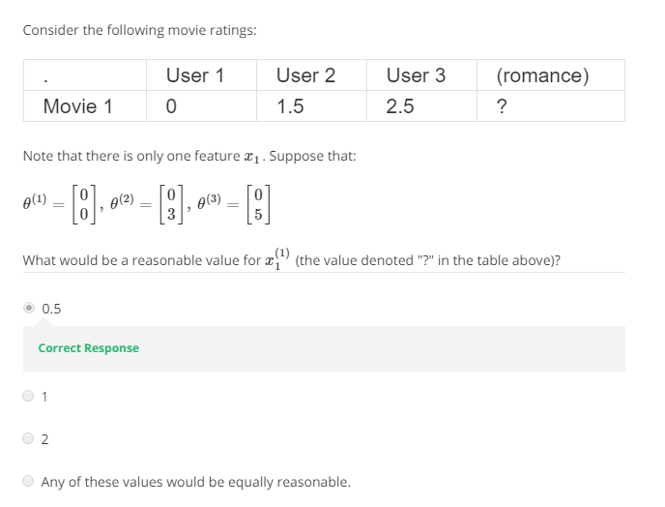

Slide 13
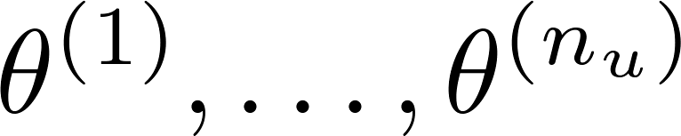

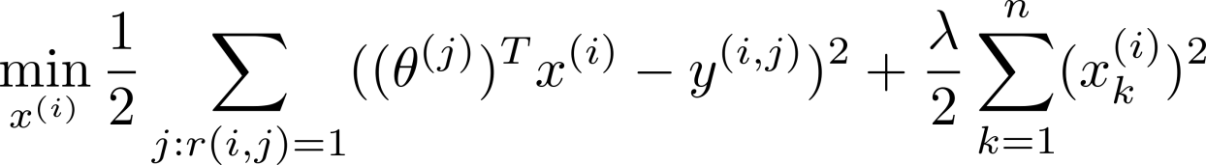
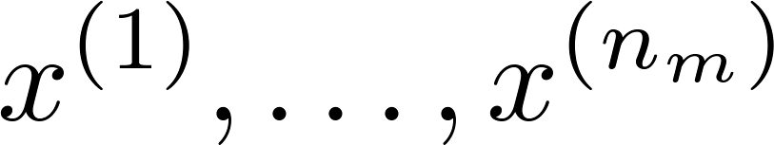
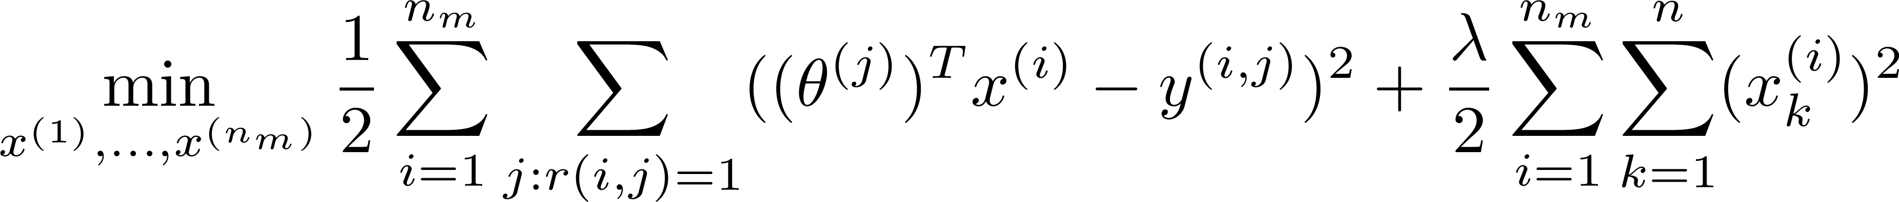
Optimization algorithm
Given , to learn :
Given , to learn :

Slide 14
Collaborative filtering
Given (and movie ratings),
can estimate
Given ,
can estimate

Slide 15
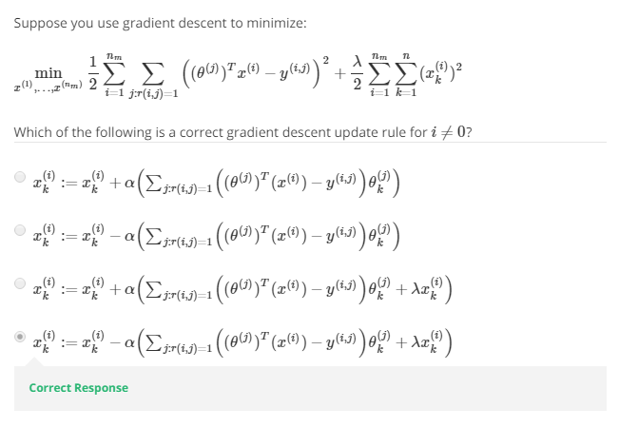

Slide 16
Recommender Systems
Collaborative filtering algorithm
Machine Learning

Slide 17
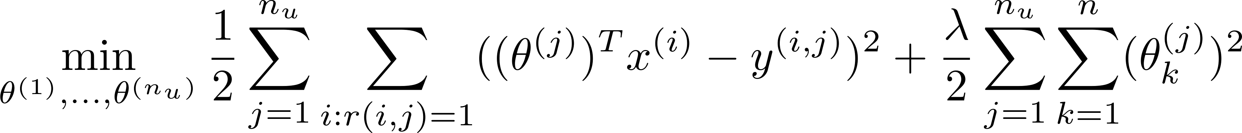

Collaborative filtering optimization objective
Given , estimate :
Given , estimate :
Minimizing and simultaneously:

Slide 18
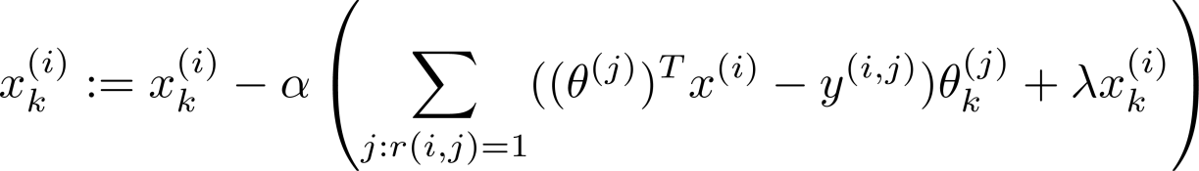
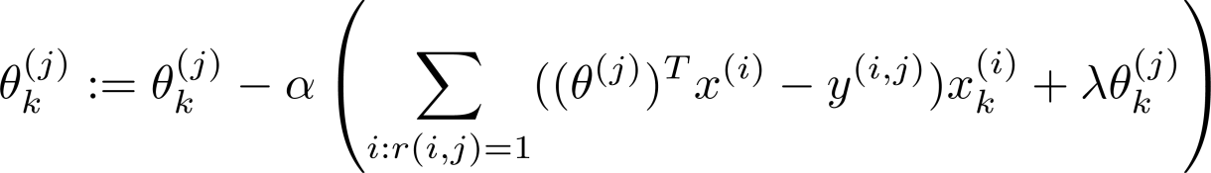

Collaborative filtering algorithm
Initialize to small random values.
Minimize using gradient descent (or an advanced optimization algorithm). E.g. for every :
For a user with parameters and a movie with (learned) features , predict a star rating of .

Slide 19
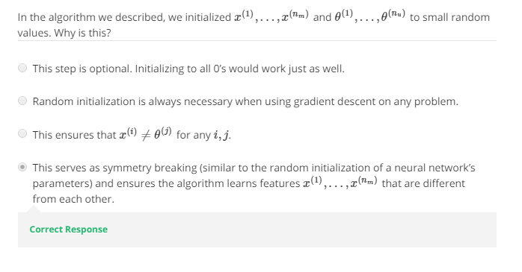

Slide 20
Recommender Systems
Vectorization: Low rank matrix factorization
Machine Learning

Slide 21
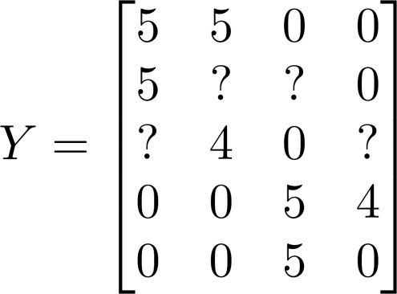
Collaborative filtering
Movie | Alice (1) | Bob (2) | Carol (3) | Dave (4)
Love at last | 5 | 5 | 0 | 0
Romance forever | 5 | ? | ? | 0
Cute puppies of love | ? | 4 | 0 | ?
Nonstop car chases | 0 | 0 | 5 | 4
Swords vs. karate | 0 | 0 | 5 | ?
Notes:
Make points have 0 mean on x1 and x2

Slide 22
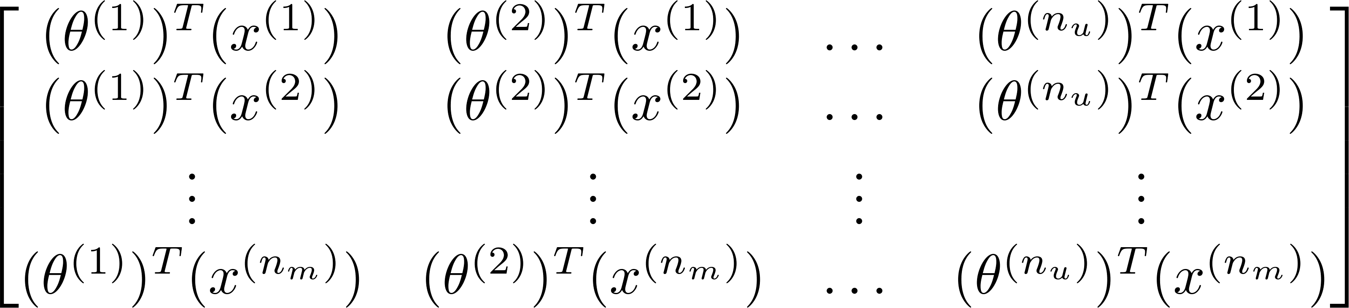
Collaborative filtering
Predicted ratings:
Notes:
Make points have 0 mean on x1 and x2

Slide 23
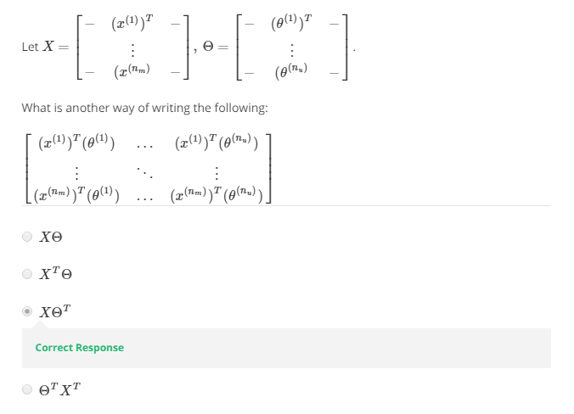

Slide 24
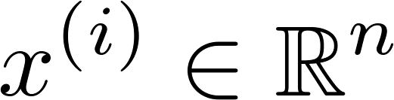

Finding related movies
For each product , we learn a feature vector .
How to find movies related to movie ?
5 most similar movies to movie :
Find the 5 movies with the smallest .
Notes:
Make points have 0 mean on x1 and x2

Slide 25
Recommender Systems
Implementational detail: Mean normalization
Machine Learning

Slide 26
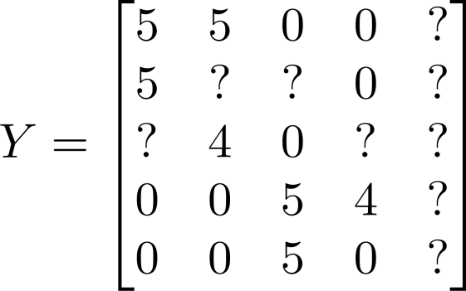

Users who have not rated any movies
Movie | Alice (1) | Bob (2) | Carol (3) | Dave (4) | Eve (5)
Love at last | 5 | 5 | 0 | 0 | ?
Romance forever | 5 | ? | ? | 0 | ?
Cute puppies of love | ? | 4 | 0 | ? | ?
Nonstop car chases | 0 | 0 | 5 | 4 | ?
Swords vs. karate | 0 | 0 | 5 | ? | ?

Slide 27
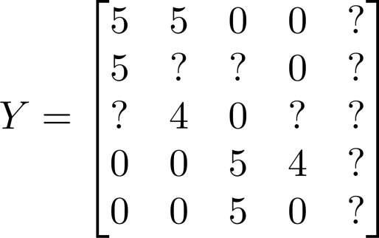
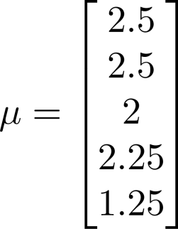
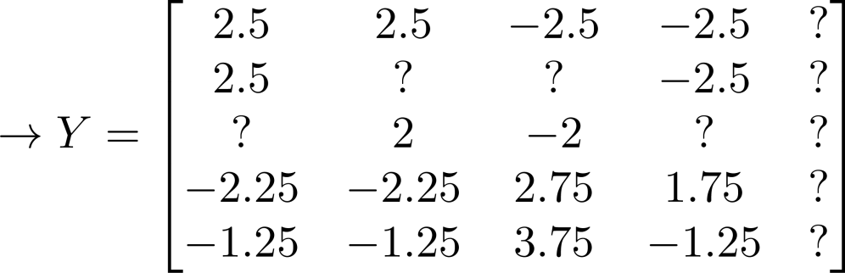

Mean Normalization:
For user , on movie predict:
User 5 (Eve):

Slide 28
